Slide 1
JumpApp
A.A. 2018 - 2019
Advanced Coding Tools and Methodologies
Olivieri Marco – Simeon Federico

Slide 2






JumpApp: what is it?
Musical didactic game
Free online browser Chrome
No download required
2
/10

Slide 3


Goals
Have fun
Recognize modal scales
Sing musical intervals
Train the relative pitch
Associate modes to their brilliance
3
/10

Slide 4
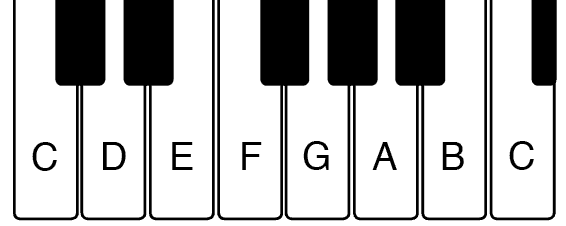
Music overview: modal scales
Lydian | C | D | E | F# | G | A | B
Ionian | C | D | E | F | G | A | B
Mixolydian | C | D | E | F | G | A | Bb
Dorian | C | D | Eb | F | G | A | Bb
Aeolian | C | D | Eb | F | G | Ab | Bb
Phrygian | C | Db | Eb | F | G | Ab | Bb
Locrian | C | Db | Eb | F | Gb | Ab | Bb
bright
dark
4
/10

Slide 5
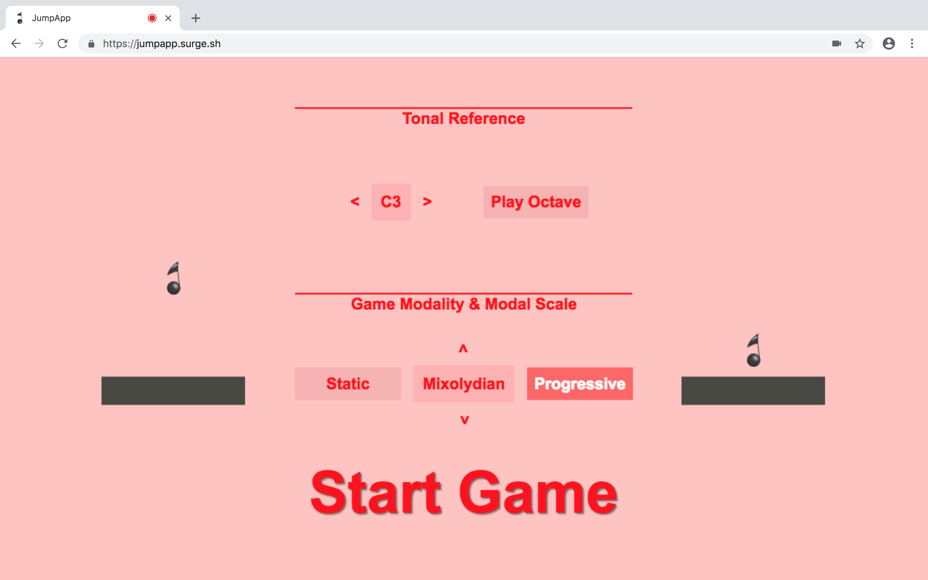
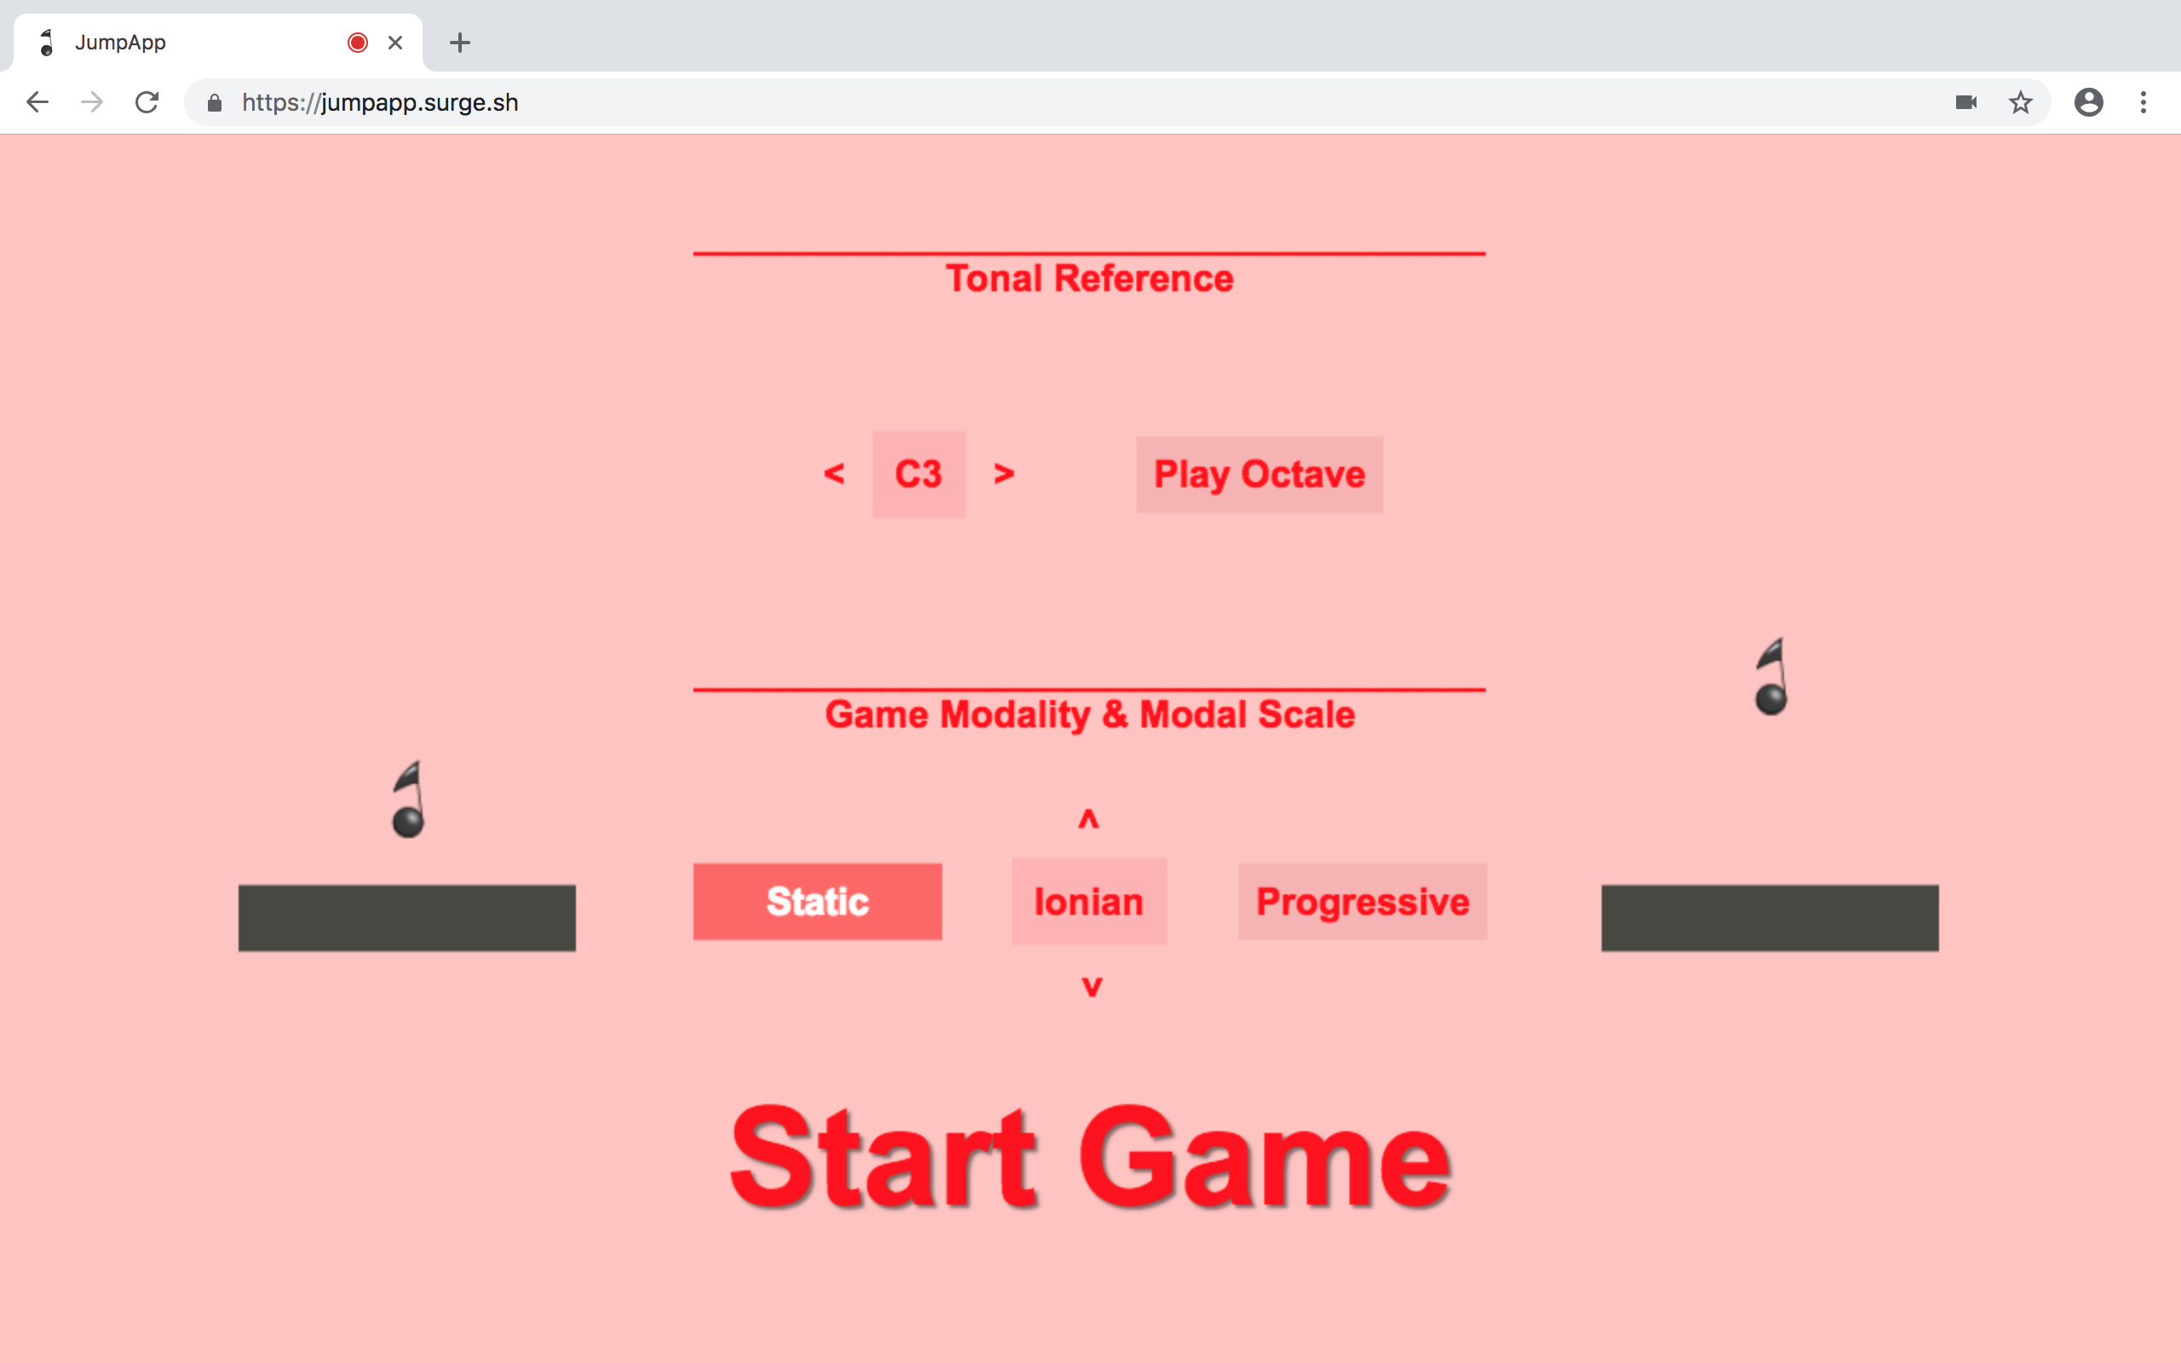
Workflow: settings
4

Slide 6
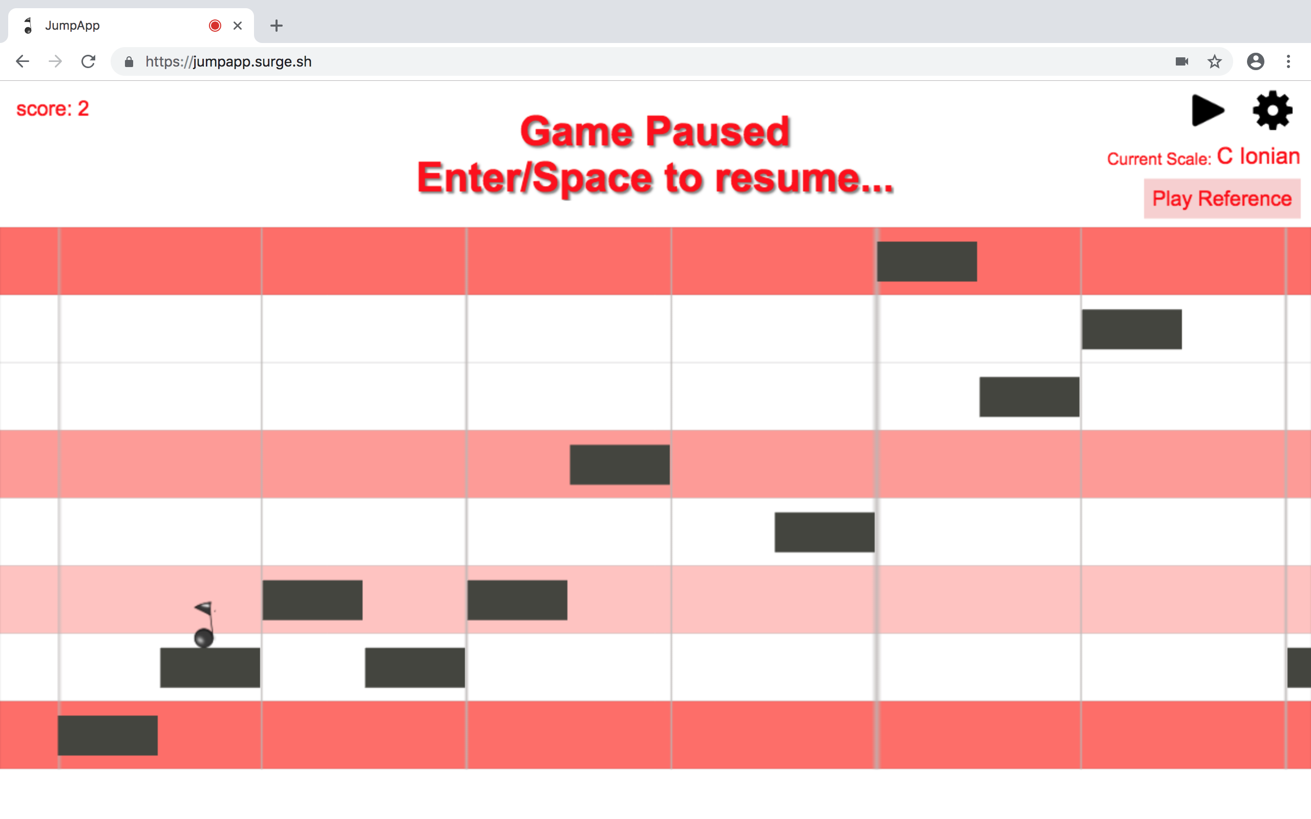
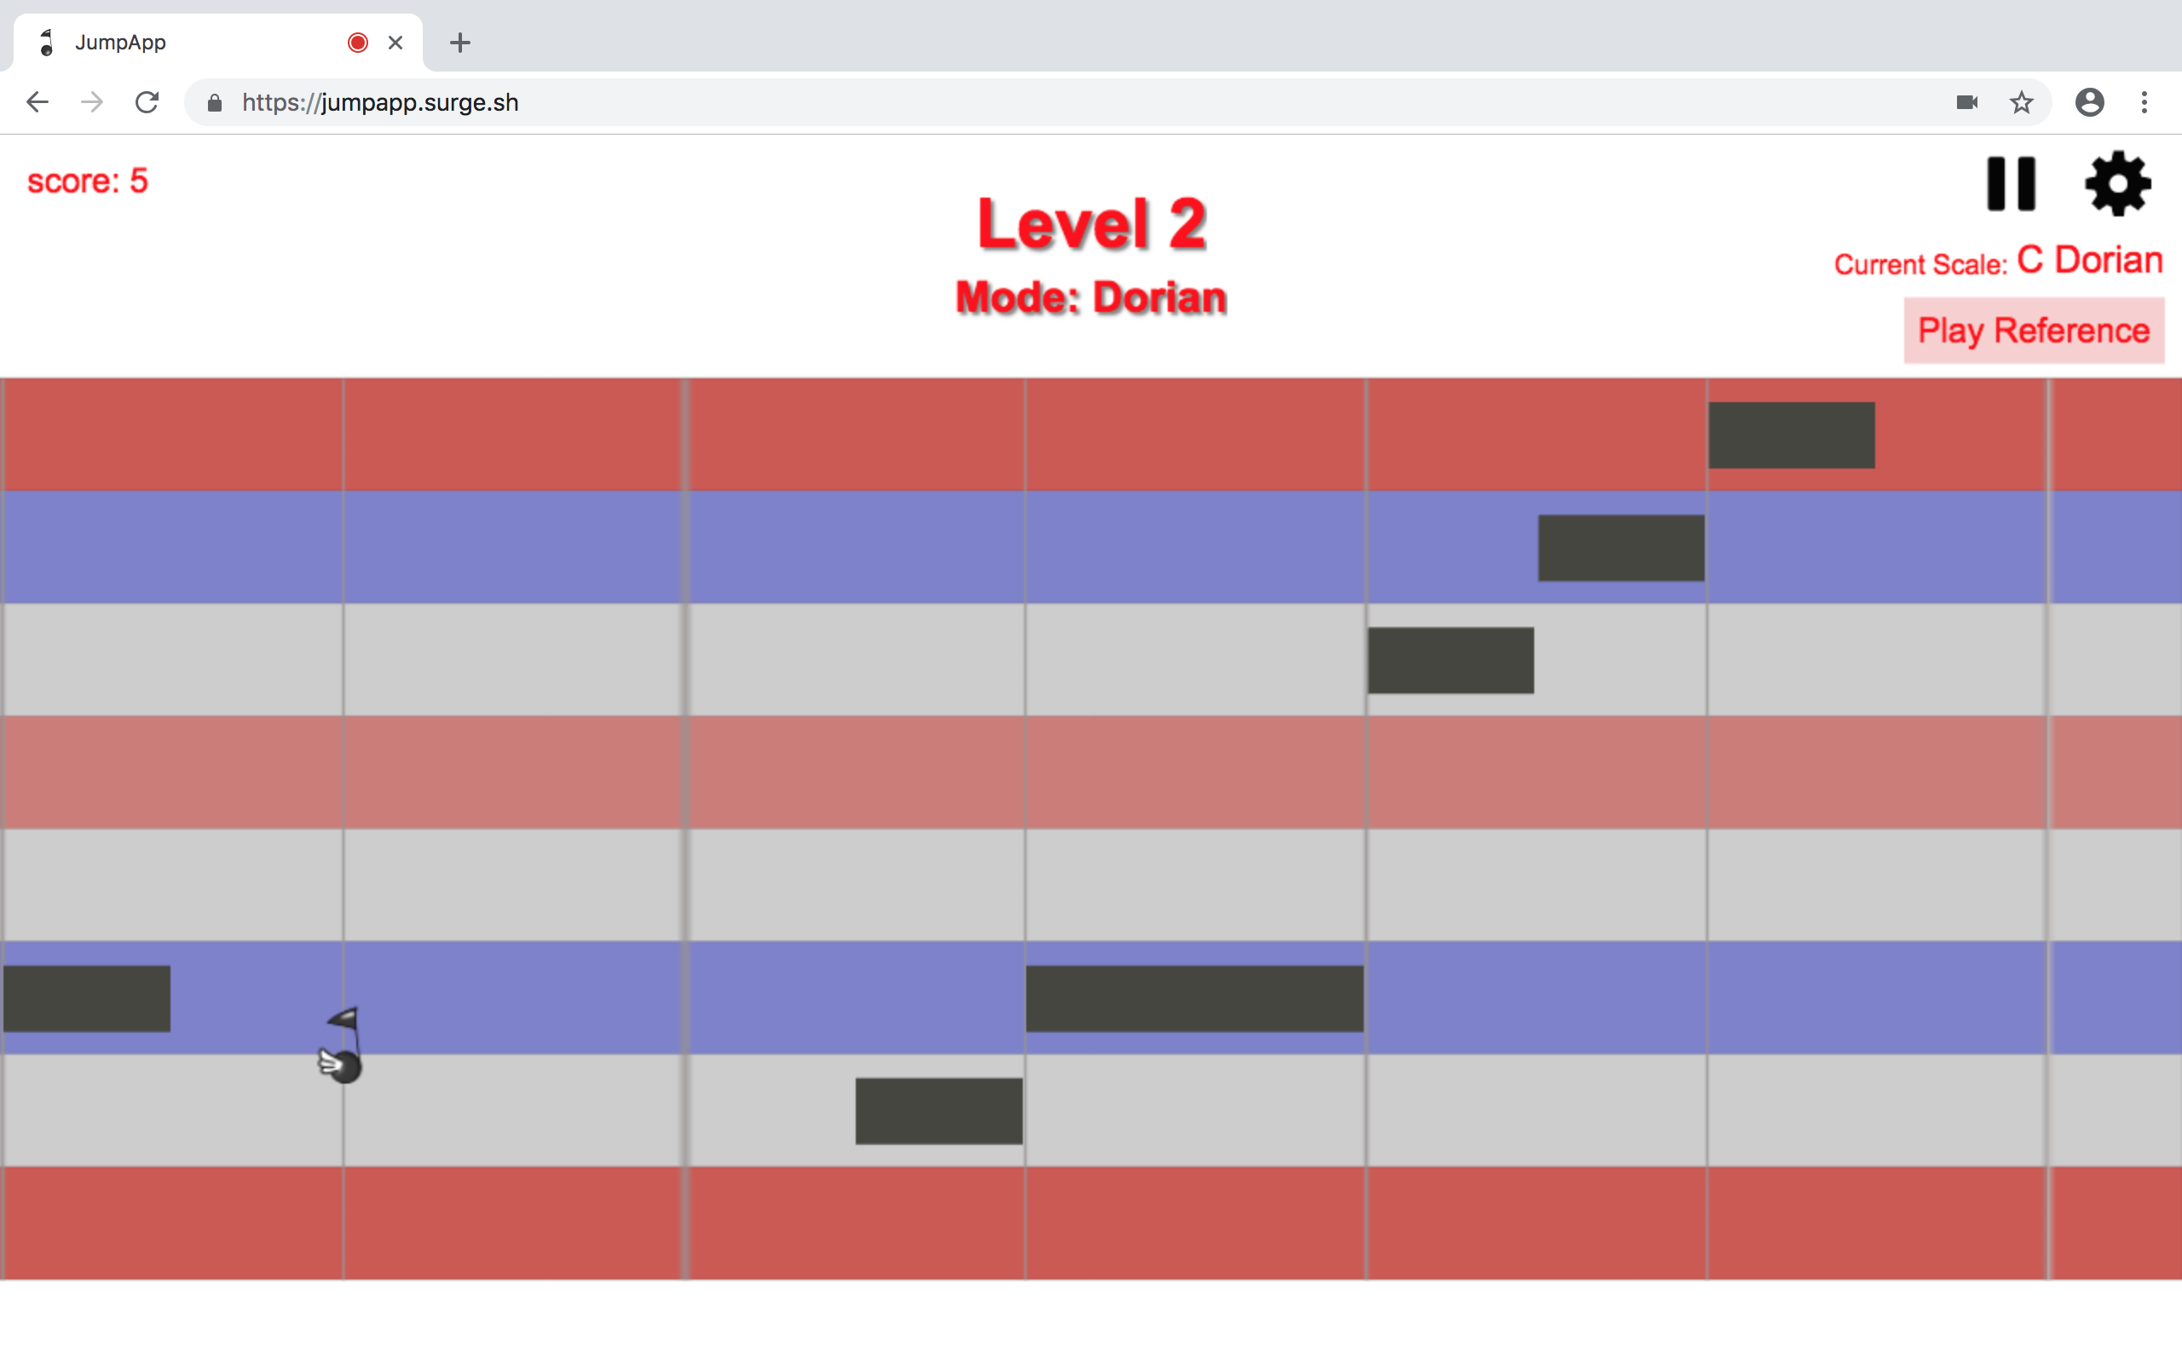
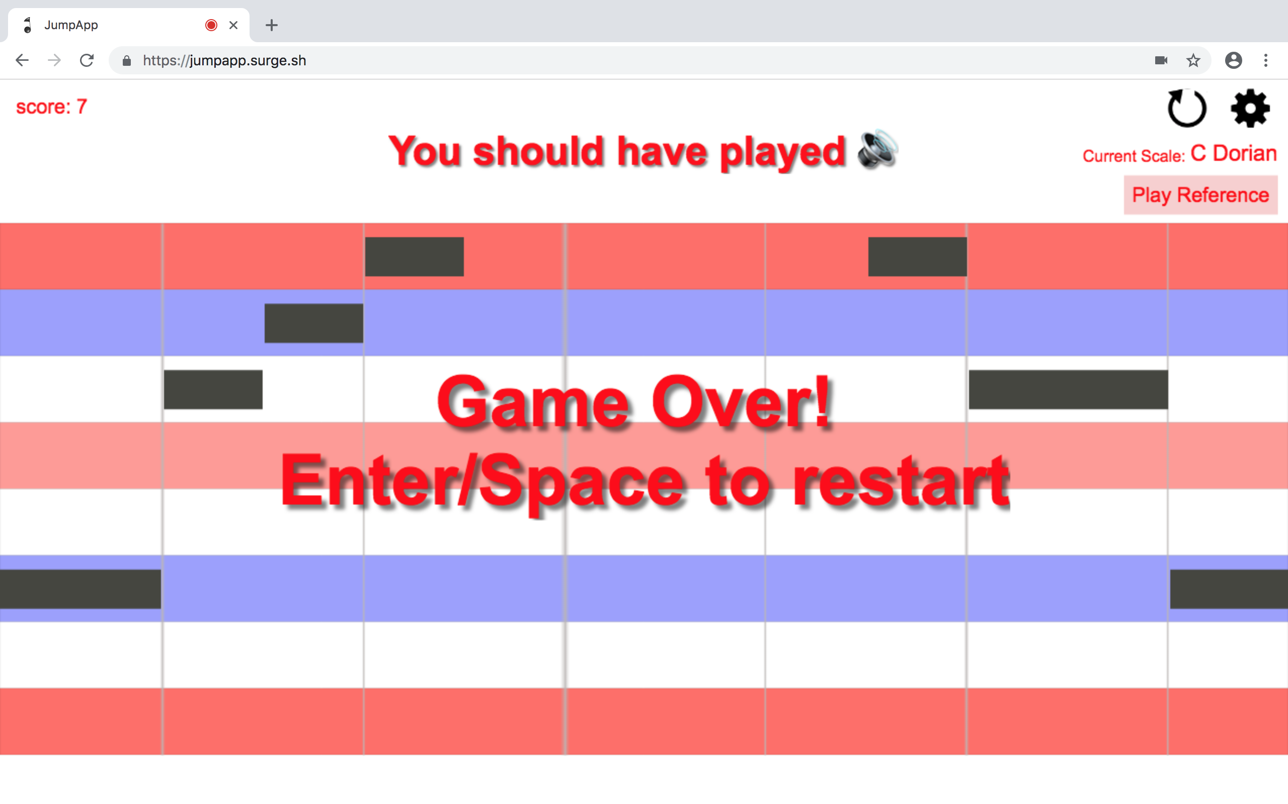
Workflow: play
- progressive
- static
- game over

Slide 7
Implementation: modules
7
/10

Slide 8
Implementation: libraries
Library | Author | Our usage | License
Phaser3 | Open community | Graphics | MIT License
AubioJS | GitHub project (Qiu Xiang) | PitchDetector | MIT License
Audiosynth | GitHub project (Keith Horwood) | Playing musical notes | MIT License
8
/10

Slide 9
Implementation: issues
Understand how external libraries work
Use and modify libraries for JumpApp purposes
Manage information flow between modules
…
9
/10

Slide 10
Future improvements
Manage note duration
Possibility to choose game velocity
Save personal points and settings of users
Play from smartphone and tablet
10
/10

Slide 11


JumpApp
February $6^{th}$, 2019

